Slide 1

Python OOP - Part 1
Classes and Objects
Program: EDGE-CSE CUET DIGITAL SKILLS TRAINING
Course: Python (Django) [Intermediate]
Lecture: Training Session-04 Date: 21st September, 2024 Duration: (1+ 1) hours
Instructor: Tanveer Rahman, Sr. Software Engineer, Friends Corp. Chuo-ku, Tokyo, JP shakil10vr@hotmail.com, 01626735005

Slide 2
Agenda
Introduction to OOP
Classes and Objects
Practical Task: Creating a Simple Class and Object
SOLID Principles

Slide 3
Object-ORIENTED Programming
What is Object-Oriented Programming?
A programming pattern based on the concept of "objects."
Key OOP principles:
Objects contain both data (attributes) and methods (functions).
Encapsulation Inheritance Polymorphism Abstraction

Slide 4
OOP principles
Encapsulation:
Hides internal details and exposes only necessary parts.
Achieved using methods and access control (private/public).
Inheritance:
Mechanism for creating a new class using the properties of an existing class.
Promotes code reuse and hierarchical relationships.
Polymorphism:
Objects of different types can be treated as objects of a common supertype.
Allows methods to be overridden or different implementations provided.
Abstraction:
Simplifies complex reality by modeling classes based on essential properties.
Achieved through abstract classes and interfaces

Slide 5
Classes
Definition:
A class is a blueprint for creating objects. It encapsulates data for the object and methods to manipulate that data.
Key Concepts:
Attributes: Variables that belong to the class (data). Methods: Functions defined within the class that operate on the attributes.
Example:
class Dog: # Constructor def __init__(self, name, breed): self.name = name self.breed = breed # Method def bark(self): return f"{self.name} says Woof!"
Benefits
Promotes code reusability. Provides a clear structure for code organization.

Slide 6
Objects
Definition:
An object is an instance of a class. It represents a specific entity with its own unique attributes.
Key Concepts:
Instantiation: The process of creating an object from a class. Each object can have different values for its attributes.
Example:
# Creating instances of the Dog class dog1 = Dog("Buddy", "Golden Retriever") dog2 = Dog("Max", "Bulldog") # Calling a method print(dog1.bark()) # Output: Buddy says Woof! print(dog2.bark()) # Output: Max says Woof!
Benefits
Allows for the creation of multiple instances with varying data. Supports encapsulation and modularity in programming.

Slide 7
Task - 1
Task (Creating a Simple Class and Object) (15 mins):
Create a class named Person with attributes name and age.
Write an __init__ method to initialize these attributes.
Write a method display_info to print the attributes.
Write a method greet to greet the Person.
Create an object of the class and print out the name and age, then greet the Person.

Slide 8
Task 2
Task (Object Manipulation) (5 mins):
Modify the Person class by adding a method update_age that allows updating the age attribute.
Create two objects of the class and update the age of one of them.
Print the updated details of both objects.

Slide 9
Introduction to SOLID Principles
What are SOLID Principles?
A set of five design principles to make your code more modular, maintainable, and scalable.
They help in writing flexible and reusable code, improving software design and architecture.

Slide 10
Overview of SOLID Principles
S - Single Responsibility Principle (SRP):
A class should have one and only one reason to change, meaning it should only have one job or responsibility.
O - Open/Closed Principle (OCP):
Software entities (classes, modules, functions) should be open for extension but closed for modification. You should be able to add new functionality without changing existing code.
L - Liskov Substitution Principle (LSP):
Subtypes should be substitutable for their base types. That is, an object of a subclass should be able to replace an object of its parent class without affecting the correctness of the program.
I - Interface Segregation Principle (ISP):
Clients should not be forced to depend on methods they do not use. Interfaces should be small and specific to the clients that use them.
D - Dependency Inversion Principle (DIP):
High-level modules should not depend on low-level modules. Both should depend on abstractions. This helps in reducing the coupling between the components of the system.

Slide 11
Why SOLID Matters in OOP
Encourages cleaner code and better structure.
Minimizes dependencies, making it easier to update or extend code.
Reduces the risk of bugs when making changes.
Helps you write maintainable and scalable software.

Slide 12
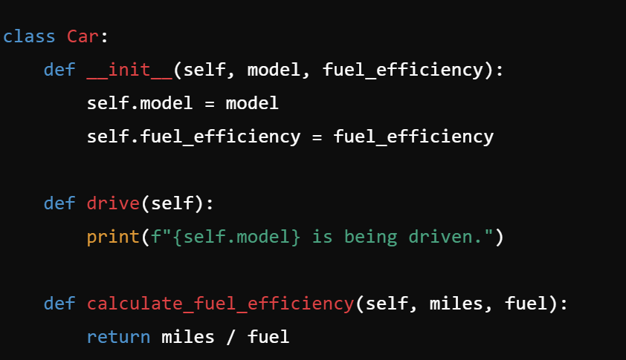
Task 3
Task (Practical Example of Single Responsibility Principle (SRP)) (10 min):
Create a Car class with methods for both drive() and calculate_fuel_efficiency().
Apply the Single Responsibility Principle by refactoring the code to separate the fuel calculation logic into a new FuelEfficiencyCalculator class.
Code Skeleton:

Slide 13
RECAP
Classes & Objects:
Classes define the blueprint for creating objects.
Objects are instances of classes with attributes (data) and methods (behaviors).
OOP Principles:
Encapsulation
Intro to SOLID Principles:
S: Single Responsibility - Each class should have one job.
O: Open/Closed - Classes should be open for extension but closed for modification.
L: Liskov Substitution - Derived classes must be replaceable by their base class.
I: Interface Segregation - No class should be forced to implement interfaces it doesn't use.
D: Dependency Inversion - High-level modules should not depend on low-level modules.
Inheritance
Polymorphism
Abstraction

Slide 14

Q&A Session

